Slide 1
Deep Learning Theory: Optimization convergence (II)
朱桢源
数学科学学院
zhenyuanzhu@pku.edu.cn

Slide 2
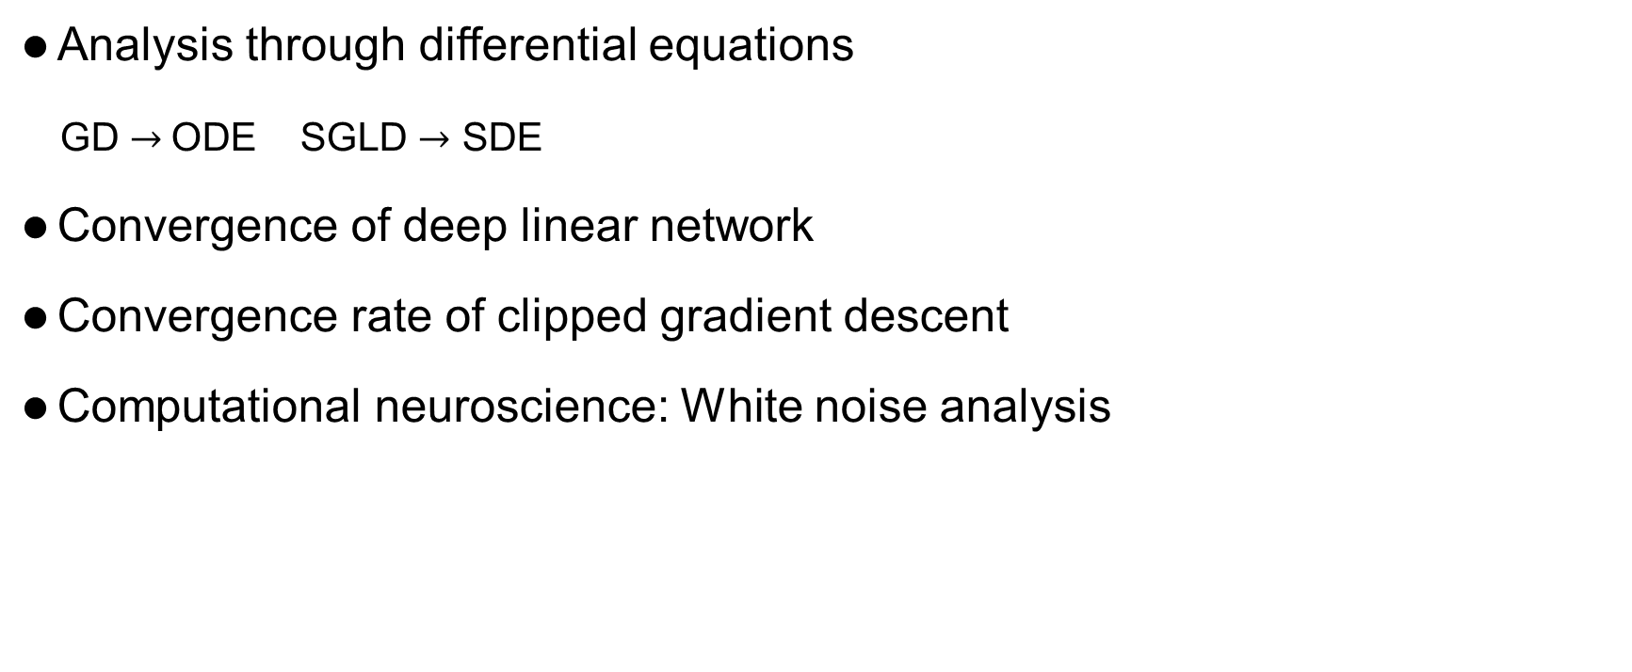
Outline
Analysis through differential equations
GD $→$ODE SGLD $→$ SDE
Convergence of deep linear network
Convergence rate of clipped gradient descent
Computational neuroscience: White noise analysis

Slide 3
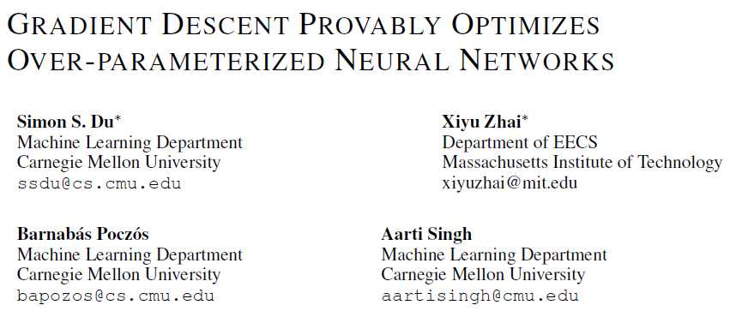
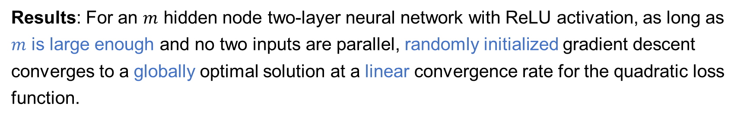
Results: For an $m$ hidden node two-layer neural network with ReLU activation, as long as $m$ is large enough and no two inputs are parallel, randomly initialized gradient descent converges to a globally optimal solution at a linear convergence rate for the quadratic loss function.

Slide 4
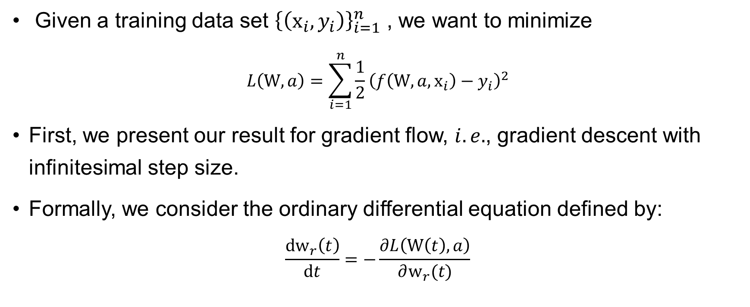
Continuous time analysis
Given a training data set ${\left\{\left(x_{i},y_{i}\right)\right\}}_{i=1}^{n}$ , we want to minimize
$$L\left(W,a\right)=\sum_{i=1}^{n}{\frac{1}{2}}{\left(f\left(W,a,x_{i}\right)−y_{i}\right)}^{2}$$
First, we present our result for gradient flow, $i.e.$, gradient descent with infinitesimal step size.
Formally, we consider the ordinary differential equation defined by:
$$\frac{dw_{r}\left(t\right)}{dt}=−\frac{∂L\left(W\left(t\right),a\right)}{∂w_{r}(t)}$$

Slide 5
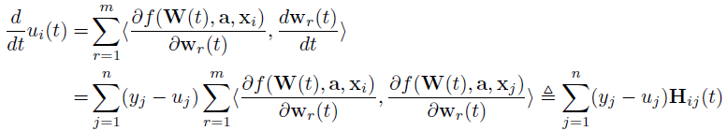
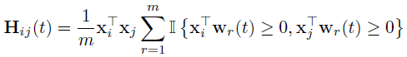
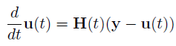
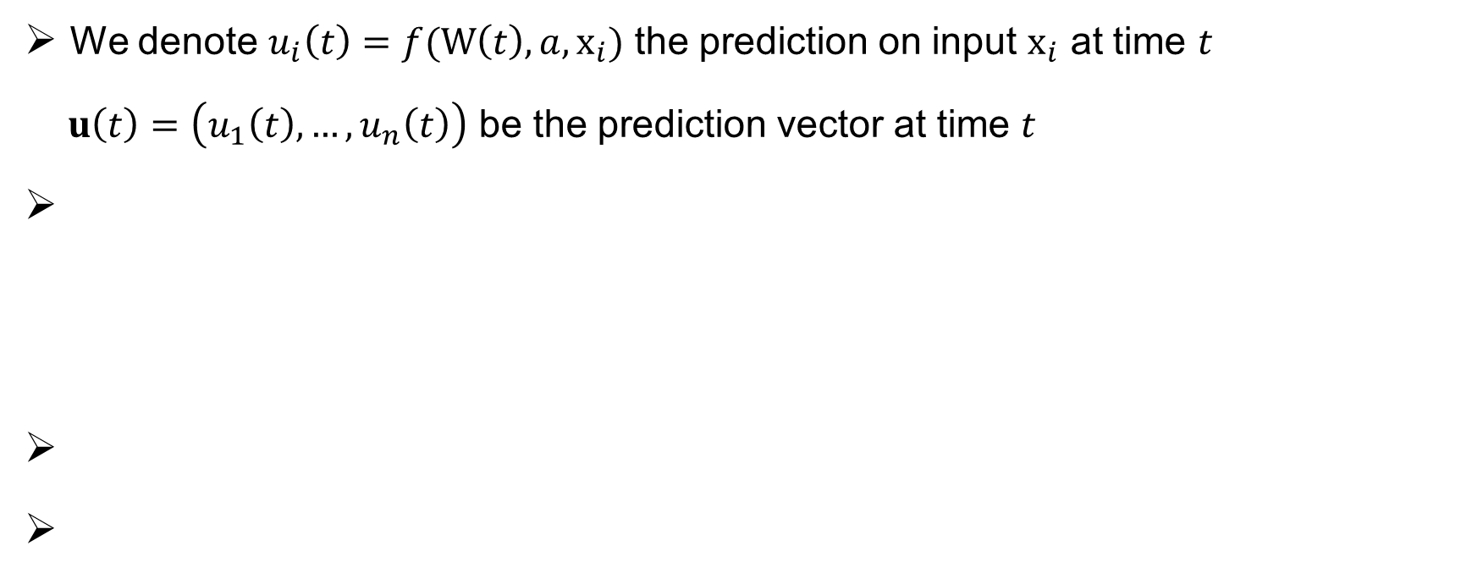
ODE formalization
We denote $u_{i}\left(t\right)=f(W\left(t\right),a,x_{i})$ the prediction on input $x_{i}$ at time $t$
$u\left(t\right)=\left(u_{1}\left(t\right),…,u_{n}\left(t\right)\right)$ be the prediction vector at time $t$

Slide 6
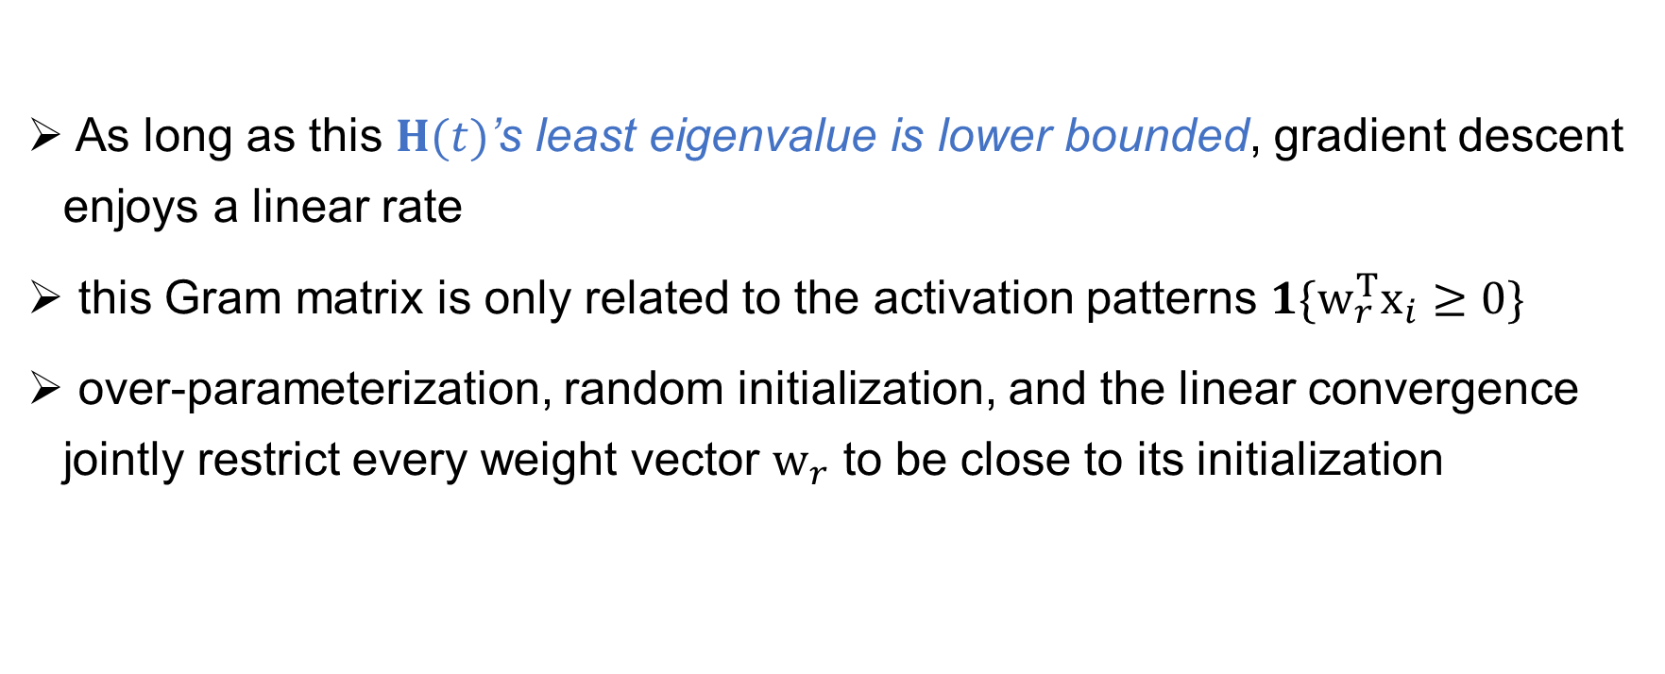
Three observations
As long as this $H(t)$’s least eigenvalue is lower bounded, gradient descent enjoys a linear rate
this Gram matrix is only related to the activation patterns $1\{w_{r}^{T}x_{i}≥0\}$
over-parameterization, random initialization, and the linear convergence jointly restrict every weight vector $w_{r}$ to be close to its initialization

Slide 7
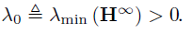
Proof sketch
We assume

Slide 8
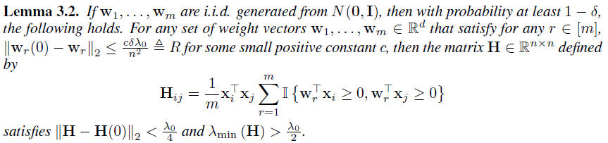
Proof sketch

Slide 9
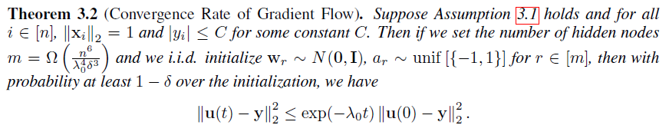
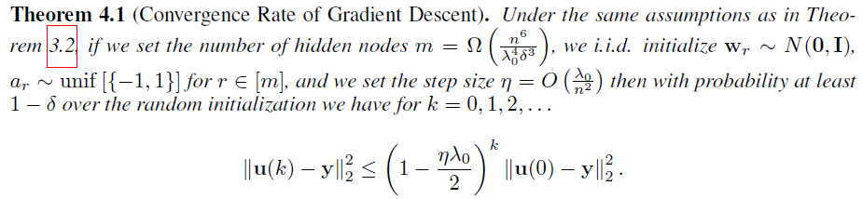
From gradient flow to gradient descent

Slide 10
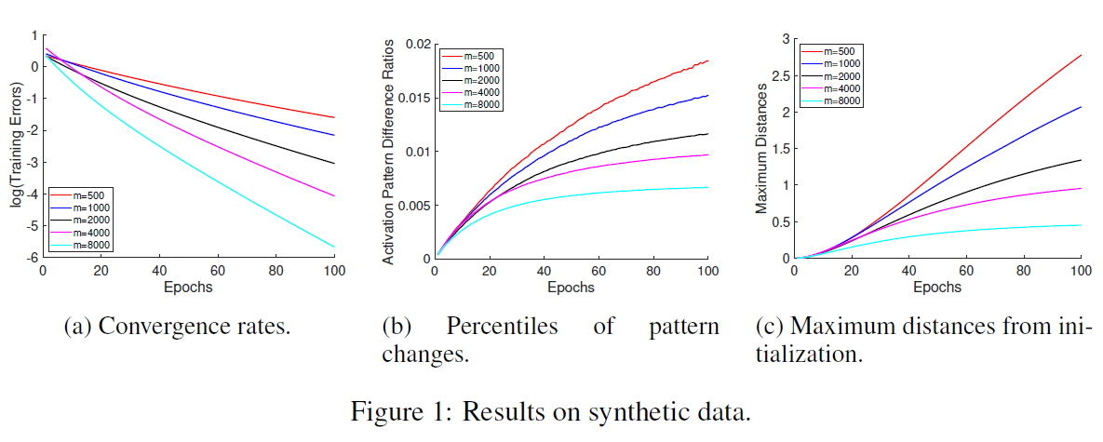
Experiments

Slide 11
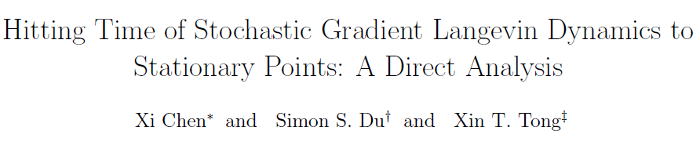
Results :
A direct analysis for hitting time of SGLD for the first and second order stationary points
Applications: online linear regression, online matrix factorization, and online PCA
Promising to extend the techniques to deep neural networks

Slide 12
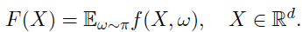
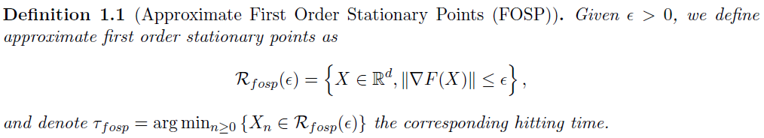
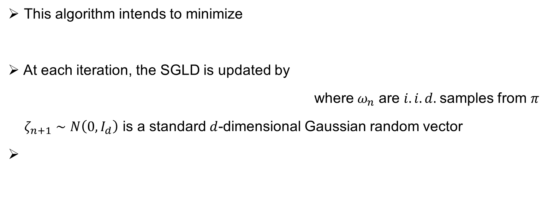
Stochastic Gradient Langevin Dynamics (SGLD)
This algorithm intends to minimize
At each iteration, the SGLD is updated by
where${ ω}_{n}$ are $i.i.d.$samples from $π$
$ζ_{n+1}∼N\left(0,I_{d}\right)$ is a standard $d$-dimensional Gaussian random vector

Slide 13
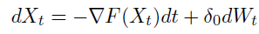
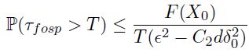
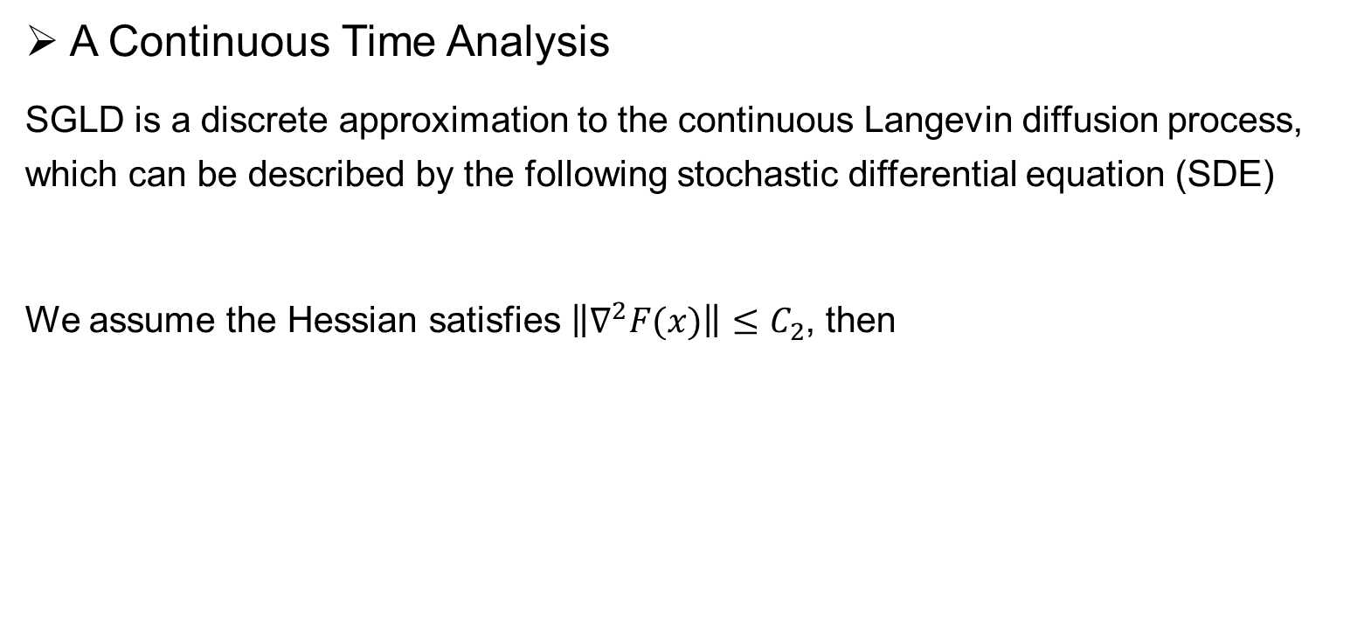
Hitting Time to First Order Stationary Points
A Continuous Time Analysis
SGLD is a discrete approximation to the continuous Langevin diffusion process, which can be described by the following stochastic differential equation (SDE)
We assume the Hessian satisfies $\left\|∇^{2}F(x)\right\|≤C_{2}$, then

Slide 14
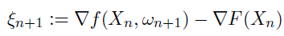
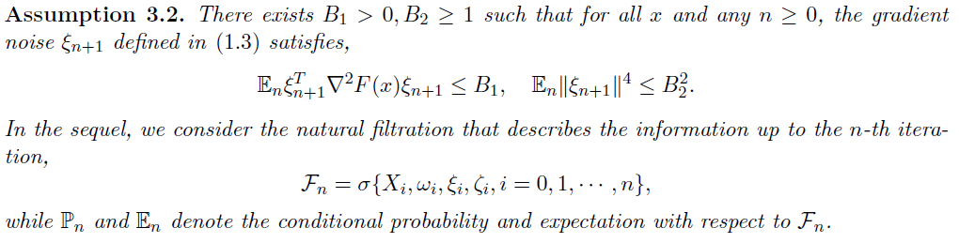
Hitting Time to First Order Stationary Points
Discrete Time SGLD Analysis

Slide 15
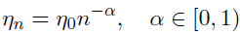
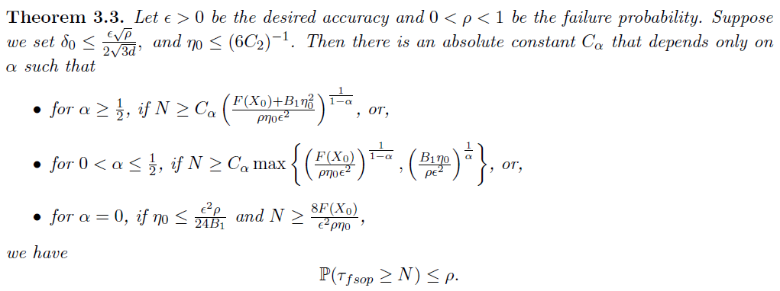
Hitting Time to First Order Stationary Points
Discrete Time SGLD Analysis stepsize

Slide 16
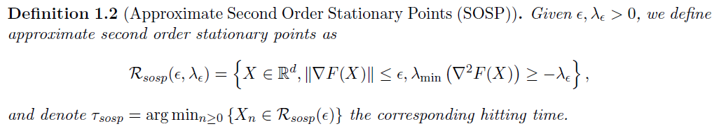
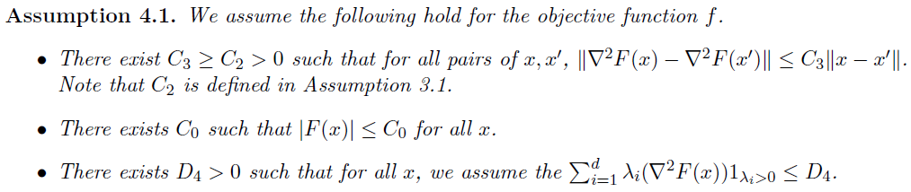
Hitting Time to Second Order Stationary Points

Slide 17
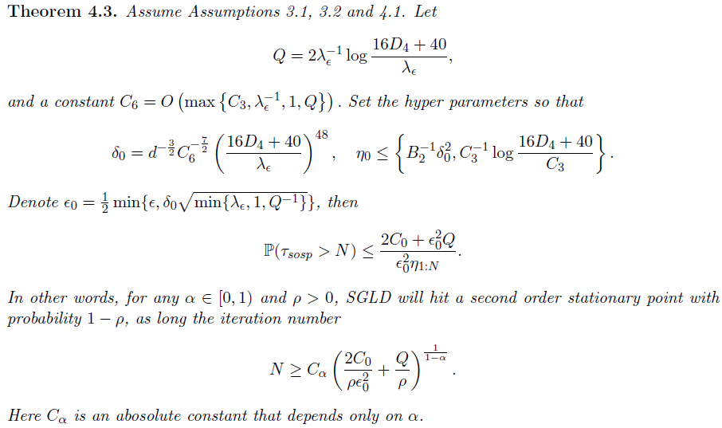
Hitting Time to Second Order Stationary Points

Slide 18
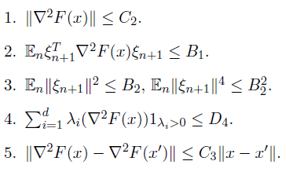
Applications
As long as the objective function satisfies some smoothness conditions and the noise satisfies certain moment conditions, then SGLD hits a first/second order stationary point in polynomial time in terms of the following parameters:

Slide 19
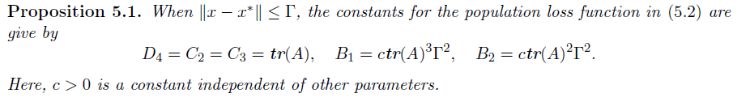
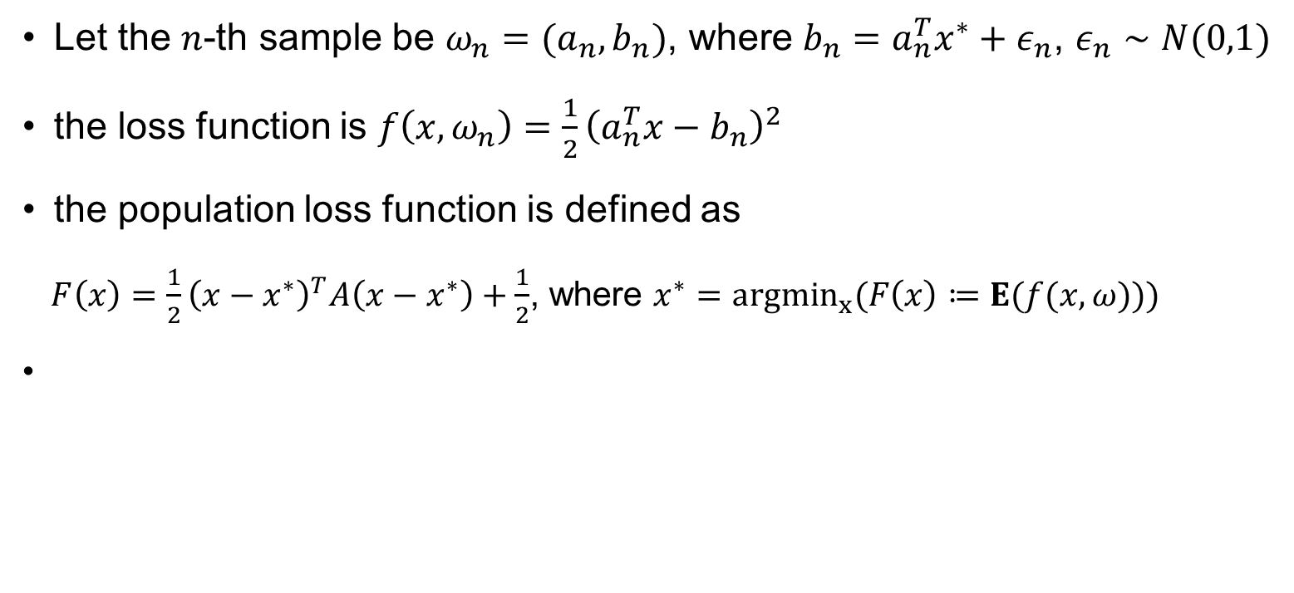
Example: Linear regression
Let the $n$-th sample be $ω_{n}=(a_{n}, b_{n})$, where $b_{n}=a_{n}^{T}x^{∗}+ε_{n}$, $ε_{n}∼N(0,1)$
the loss function is $f\left(x,ω_{n}\right)=\frac{1}{2}{\left(a_{n}^{T}x−b_{n}\right)}^{2}$
the population loss function is defined as
$F\left(x\right)=\frac{1}{2}{\left(x−x^{∗}\right)}^{T}A\left(x−x^{∗}\right)+\frac{1}{2}$, where $x^{∗}=argmin_{x}(F\left(x\right)≔E(f(x, ω)))$

Slide 20
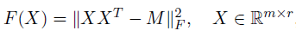
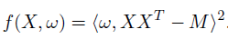
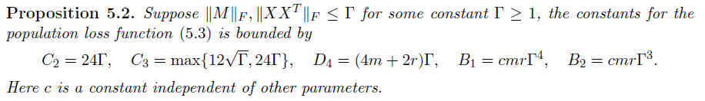
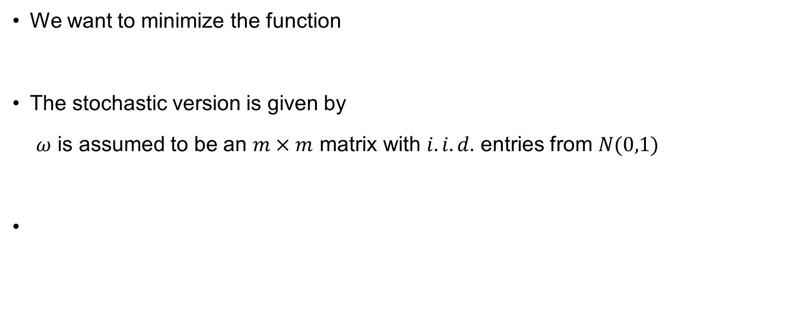
Example: Matrix Factorization
We want to minimize the function
The stochastic version is given by
$ω$ is assumed to be an $m×m$ matrix with $i.i.d.$ entries from $N(0,1)$

Slide 21
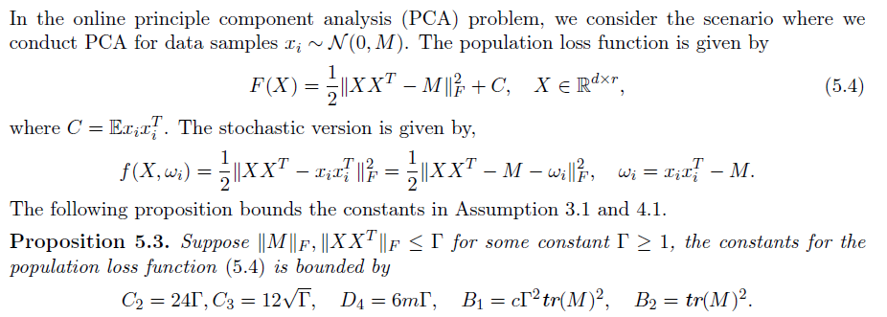
Example: Online PCA

Slide 22
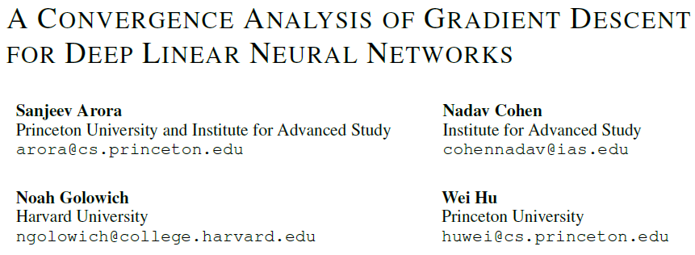
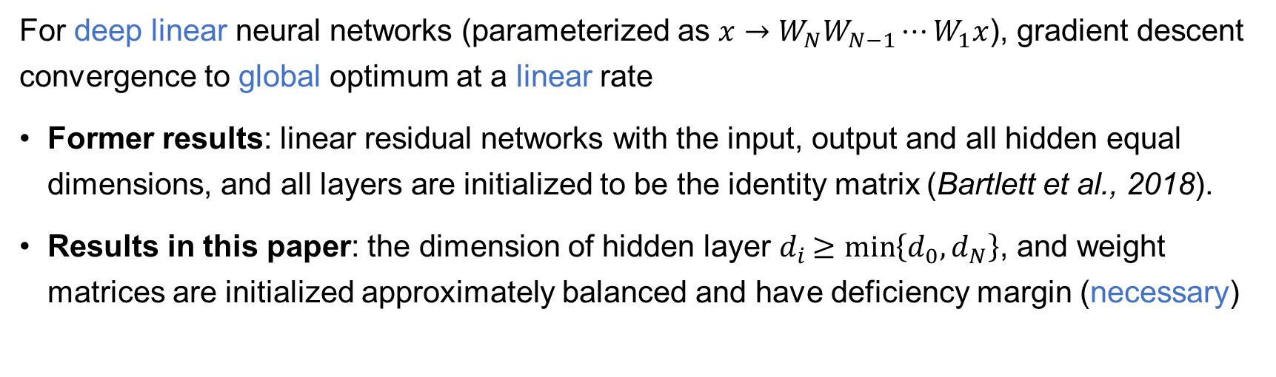
For deep linear neural networks (parameterized as $x→W_{N}W_{N−1}⋯W_{1}x$), gradient descent convergence to global optimum at a linear rate
Former results: linear residual networks with the input, output and all hidden equal dimensions, and all layers are initialized to be the identity matrix (Bartlett et al., 2018).
Results in this paper: the dimension of hidden layer $d_{i}≥min\left\{d_{0}, d_{N}\right\}$, and weight matrices are initialized approximately balanced and have deficiency margin (necessary)

Slide 23
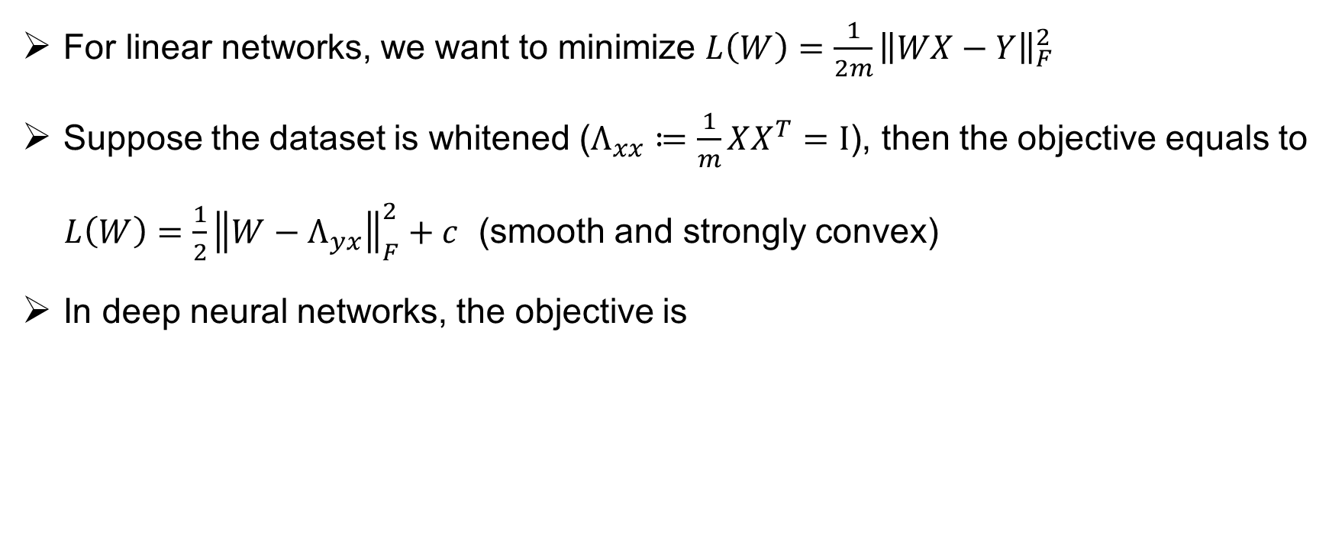
Problem setup
For linear networks, we want to minimize $L\left(W\right)=\frac{1}{2m}{\left\|WX−Y\right\|}_{F}^{2}$
Suppose the dataset is whitened ($Λ_{xx}≔\frac{1}{m}XX^{T}=I$), then the objective equals to
$L\left(W\right)=\frac{1}{2}{\left\|W−Λ_{yx}\right\|}_{F}^{2}+c$ (smooth and strongly convex)
In deep neural networks, the objective is

Slide 24
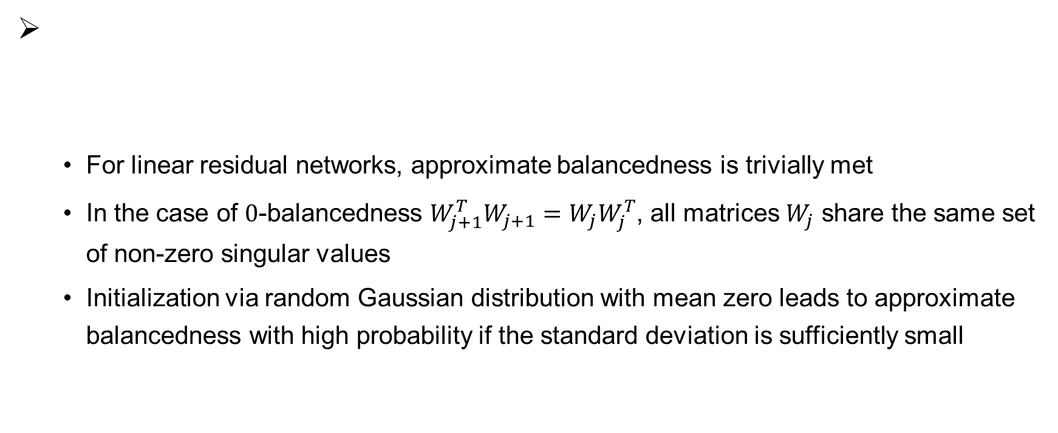
Assumption1: balancedness
For linear residual networks, approximate balancedness is trivially met
In the case of $0$-balancedness $W_{j+1}^{T}W_{j+1}=W_{j}W_{j}^{T}$, all matrices $W_{j}$ share the same set of non-zero singular values
Initialization via random Gaussian distribution with mean zero leads to approximate balancedness with high probability if the standard deviation is sufficiently small

Slide 25
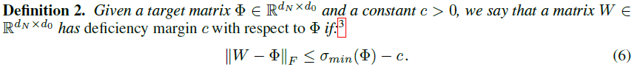
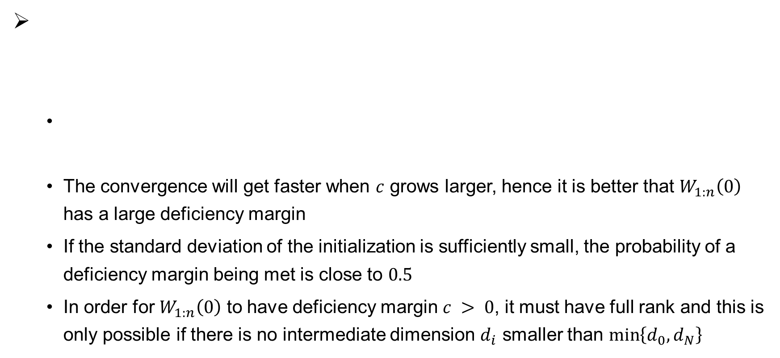
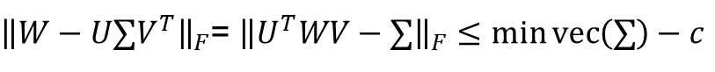
Assumption2: deficiency margin
${\left\|W−U∑V^{T}\right\|}_{F}$= ${\left\|U^{T}WV−∑\right\|}_{F}≤\min{vec\left(∑\right)−c}$
The convergence will get faster when $c$ grows larger, hence it is better that $W_{1:n}\left(0\right)$ has a large deficiency margin
If the standard deviation of the initialization is sufficiently small, the probability of a deficiency margin being met is close to $0.5$
In order for $W_{1:n}\left(0\right)$ to have deficiency margin $c > 0$, it must have full rank and this is only possible if there is no intermediate dimension $d_{i}$ smaller than $\min\left\{d_{0}, d_{N}\right\}$

Slide 26
Trade off in initialization
Taking into account the need for both approximate balancedness and deficiency margin at initialization
If the standard deviation is small, it is likely that weights be highly balanced and a deficiency margin be met
Vanishing gradient problem: overly small standard deviation will render high magnitude for the deficiency margin improbable, and therefore fast convergence is less likely to happen
Exploding gradient problem: large standard deviation jeopardizes both balancedness and deficiency margin, putting the entire convergence at risk

Slide 27
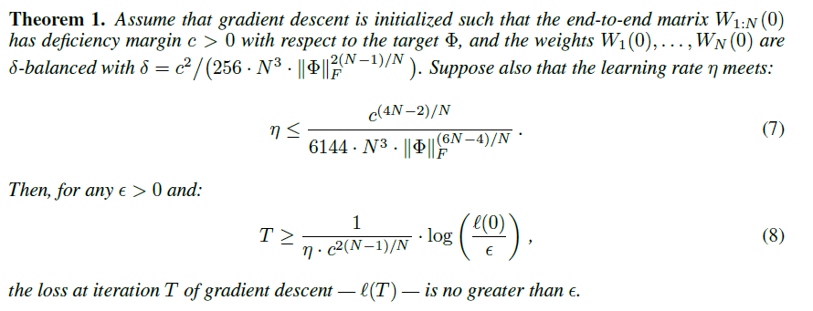
Main theorem

Slide 28
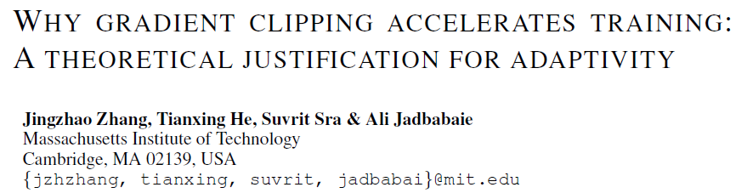
Contributions:
Introduce a relaxation of gradient smoothness that is strictly weaker than Lipschitz smoothness
Under the new condition, gradient clipping and normalized gradient converge arbitrarily faster than gradient descent with fixed stepsize

Slide 29
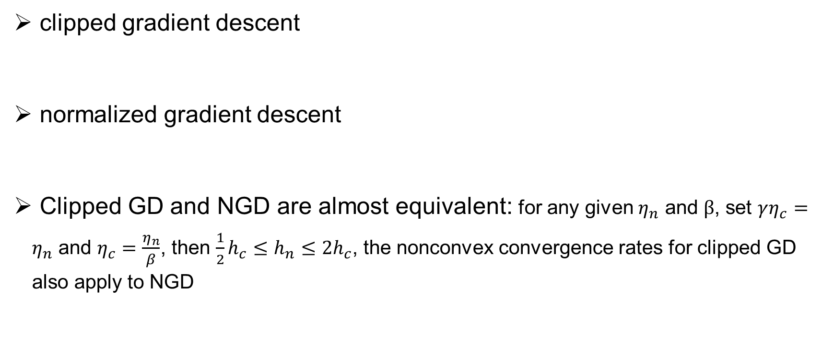
Adaptively scaled gradient methods
clipped gradient descent
normalized gradient descent
Clipped GD and NGD are almost equivalent: for any given $η_{n}$ and $β$, set $γη_{c}=η_{n}$ and $η_{c}=\frac{η_{n}}{β}$, then $\frac{1}{2}h_{c}≤h_{n}≤2h_{c}$, the nonconvex convergence rates for clipped GD also apply to NGD

Slide 30
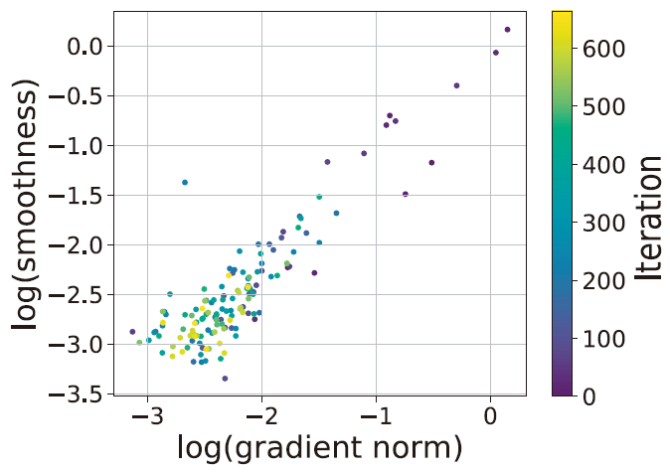
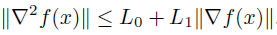
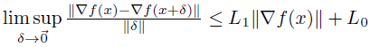
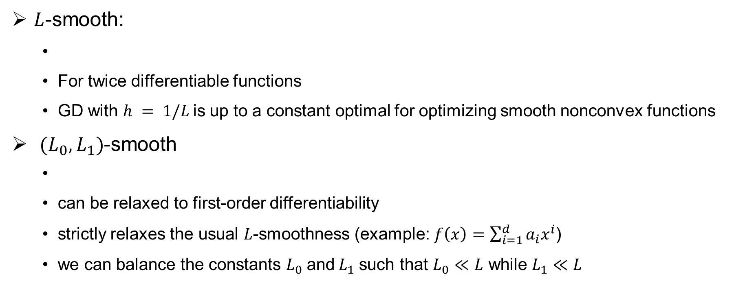
Smoothness conditions
$L$-smooth:
For twice differentiable functions
GD with $h = 1/L$is up to a constant optimal for optimizing smooth nonconvex functions
$(L_{0},L_{1})$-smooth
can be relaxed to first-order differentiability
strictly relaxes the usual $L$-smoothness (example: $f\left(x\right)=\sum_{i=1}^{d}{a_{i}x^{i}}$)
we can balance the constants $L_{0}$and$L_{1}$such that $L_{0}≪L$ while $L_{1}≪L$

Slide 31


Upper bound of clipped GD

Slide 32




Lower bound of GD
.
(example: $f\left(x\right)=\sum_{i=1}^{d}{a_{i}x^{i}}$)

Slide 33

Is positive correlations exist?
Correlation appears when the models are trained with clipped GD and large learning rates

Slide 34

Experiments
Clipping indeed accelerates convergence

Slide 35

Contributions:
Utilizing two popular methods in computational neuroscience, classification images and spike triggered averaging, to understand and interpret the behavior of artificial neural networks.

Slide 36


Classification images ( bias map / template )

Slide 37


Visualizing classifier biases

Slide 38


Adversarial attack

Slide 39


Adversarial defense

Slide 40


Filters visualization

Slide 41



Micro-stimulation

Slide 42
Conclusion
Landscape analysis: analyze non-convex optimization problems is to identify whether the optimization landscape has some good geometric properties
How to escape saddle points efficiently (Jin et al., 2017)
Escaping from saddle points -- online stochastic gradient for tensor decomposition (Ge et al., 2015)
Analysis of algorithm dynamics: analyze the dynamics of first order methods directly
Assumption: distribution of Input, two-layer network, linear network…

Slide 43
Reference
Gradient Descent Provably Optimizes Over-parameterized Neural Networks
Hitting Time of Stochastic Gradient Langevin Dynamics to Stationary Points: A Direct Analysis
A convergence analysis of gradient descent for deep linear neural networks
Why Gradient Clipping Accelerates Training: A Theoretical Justification for Adaptivity
White Noise Analysis of Neural Networks
Gradient descent with identity initialization efficiently learns positive definite linear transformations
How to escape saddle points efficiently
Escaping from saddle points -- online stochastic gradient for tensor decomposition

